Slide 1

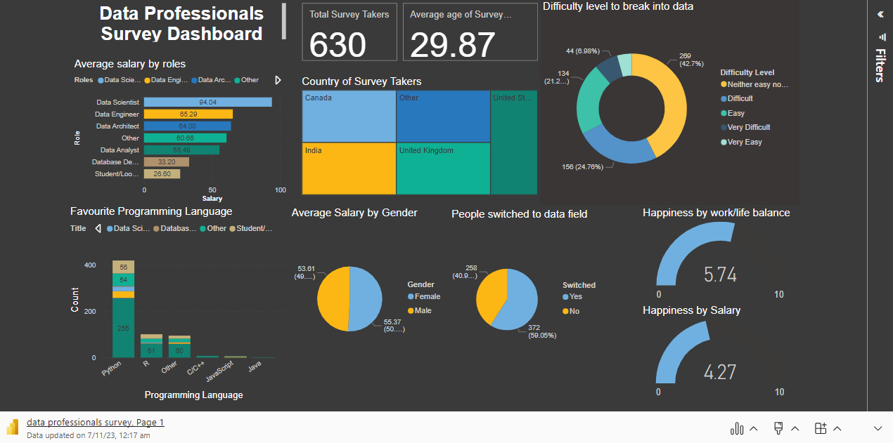
Microsoft Power BI

Slide 2
Description
The Power BI dashboard I've developed is a comprehensive and insightful visualization of the Data Professional Survey dataset. This dashboard provides a powerful tool for gaining a deep understanding of the survey's findings and trends in the field of data professionals.
At its core, this dashboard offers a user-friendly interface that allows you to interact with the data effortlessly. You can explore various aspects of the survey, such as the demographics of respondents, their roles, industry, and the tools they use. With just a few clicks, you can filter and drill down into the data to uncover valuable insights.

Slide 3
Insights
Data scientists boast some of the highest average salaries in the data industry.
Nearly 60% of individuals in the data field successfully transitioned from diverse career backgrounds.
Both men and women enjoy nearly identical salaries.
Most data professionals use Python as their primary programming language.
Python takes the lead as the primary programming language of choice for the majority of data professionals.
Nearly 43% of respondents found entering the data field to be a balanced challenge, neither too daunting nor overly straightforward.
A significant portion of individuals express dissatisfaction with their current salaries.
The work-life balance happiness score stands at a respectable 5.74 on a scale of 0 to 10, indicating a reasonably positive outlook on this crucial aspect of professional life.

